Slide 1
INTRO TO HTML
MCNDHS
Ms. Eng

Slide 2
AIM: HOW DO WE PREVIEW OUR HTML CODE?
Do now:
Grab YOUR laptop
Turn on the computer
Open the folder that we created last night
Daily Grade:
On-time/attendance/not leaving the classroom: 25%
Cellphones: 25%
Notes:25%
Classwork/Homework: 25%

Slide 3
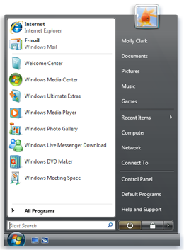
CREATING AN HTML FILE ON NOTEPAD
step 1: click on start
step 2: type in notepad

Slide 4
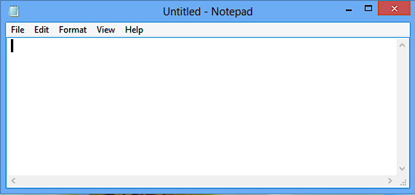
ONCE YOU HAVE NOTEPAD OPENED

Slide 5
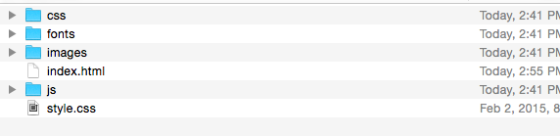
CREATING YOUR INDEX.HTML FILE
what is the index.html file?
This is the name of your homepage

Slide 6
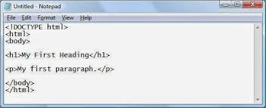
TYPE THIS

Slide 7
SAVING YOUR INDEX.HTML

